Slide 1
Linux Administration
Week 8
Security

Slide 2
Server Health Tracking - Monitoring
Allow list vs Deny list (used to be called white/black lists https://web.archive.org/web/20220902065934/https://www.ncsc.gov.uk/blog-post/terminology-its-not-black-and-white)
False Positives and False Negatives
What to keep track of
Subsystems
Memory
CPU
Disk usage
Network
Users
Processes

Slide 3

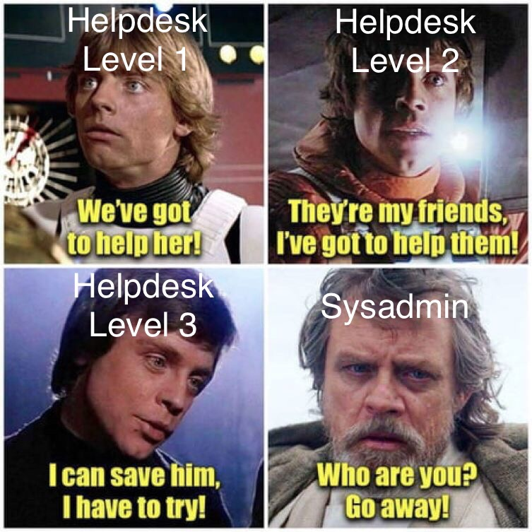
Activity
Commands to try for server monitoring
Subsystems
iostat – might need sysstat package
Nmon – likely needs to be installed
Memory
cat /proc/meminfo
CPU
Mpstat
Processes
Ps
Pstree
Network Status
Tcpdump – run as sudo
uptime

Slide 4
Hardening your system
Lock down your hardware (USB booting) and BIOS password lock
Check your file system for anomalies (Missing partitions/cmds)
Check your repos/PPA, do you still need them all?
Check your installed programs/services, are they up to date? Patches? Stil required?
Check ports and protocols (SSH access)
Root login check (Do you need it enabled?)
Is your system up to date and patched?
If your system as SELinux, enable it if possible
User password rules
Log monitoring and auditing
Backups
Chkrootkit (https://www.tecmint.com/scan-linux-for-malware-and-rootkits/)

Slide 5
Least Privilege
Policy of least privilege
What can we do to limit user access?
What should/shouldn't we do as server admins to limit access?
Security policies in general
Patching, user education, audits, password policies
Security implementation
How are we enforcing our policy?

Slide 6

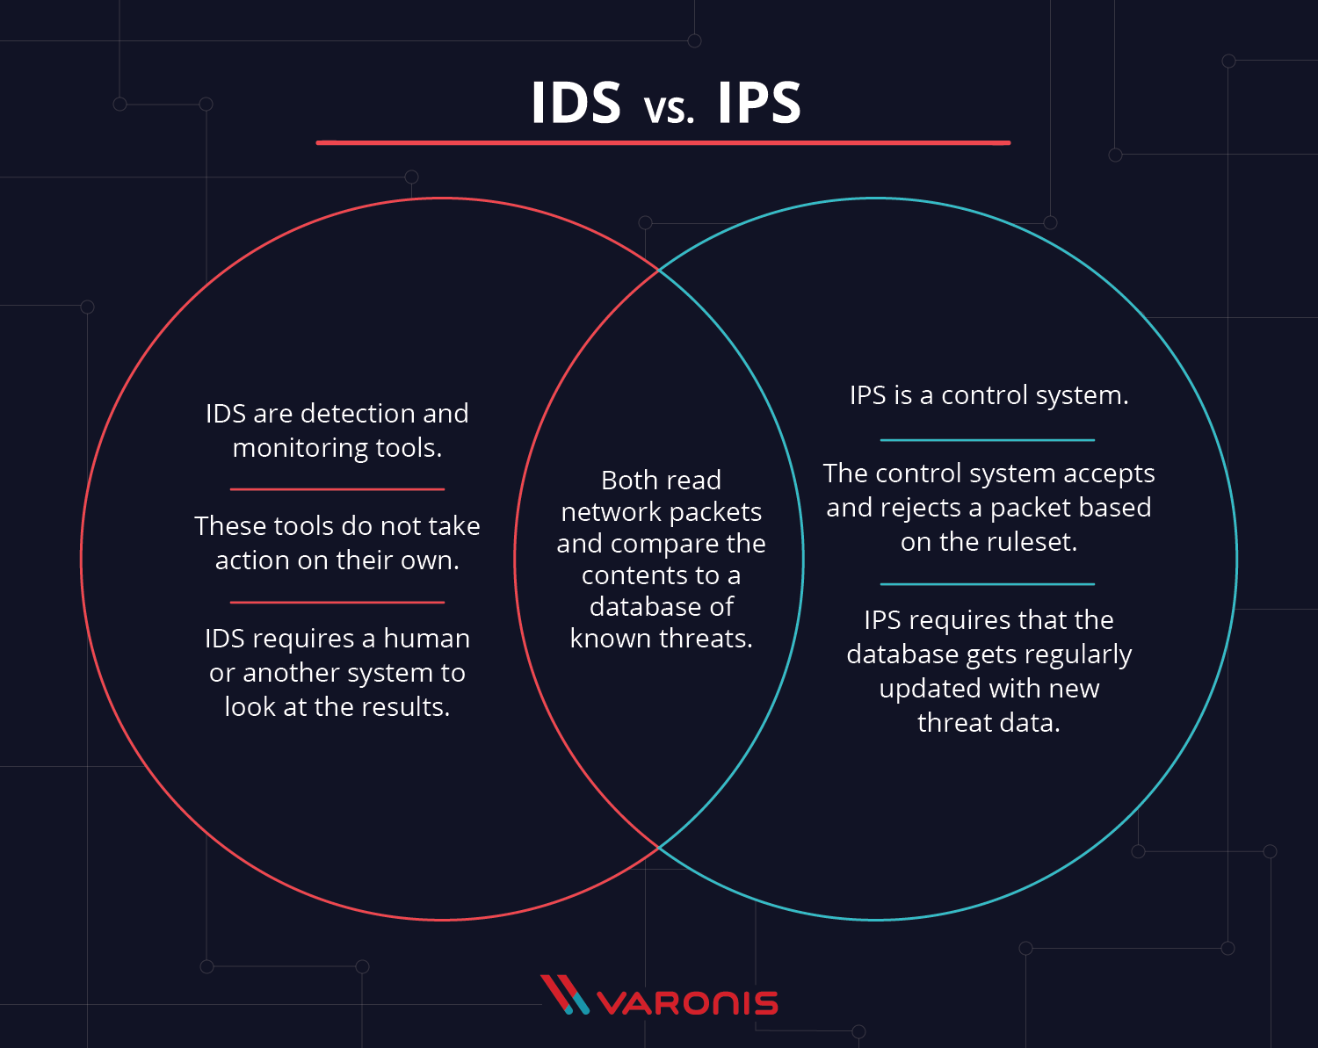
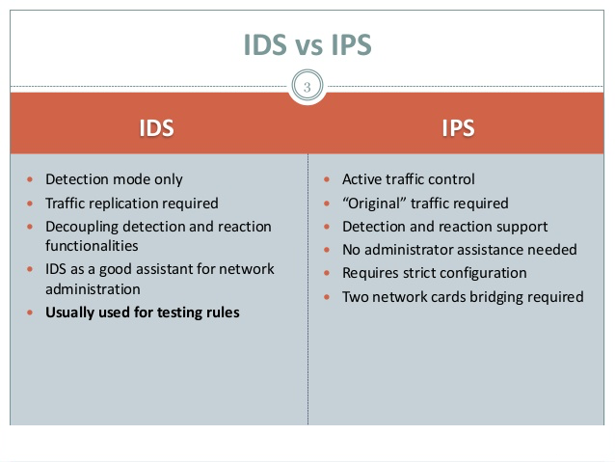



IDS vs IPS

Slide 7
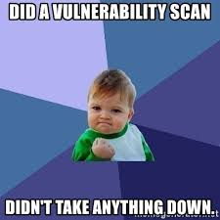
Vulnerability Scanners
Find your attack surface
Automate security audits
Help create a prioritized list of vulnerabilities
Easier to keep up to date and run quickly

Slide 8
Endpoint protections
Endpoint Protection, or Endpoint Security
Goal is to protect enterprise data even in the case of BYOD
Endpoint refers to the endpoint of the network, such as things outside the firewall
Client-Server model
Can be centrally managed server like we have here, or a SaaS (Software-as-a-Service) type solution

Slide 9
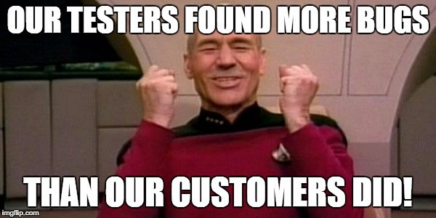
Types of scans and support
Realtime vs preset time scans
Signature vs behavioral/heuristic
Scan inbound/outbound traffic or both
Support and uptime requirements

Slide 10
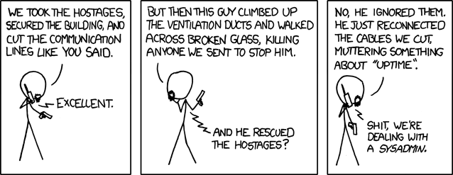
Security Health Tracking - Logs
What do we track?
Application, event, service and system logs
How long do we keep logs?
When to review logs
Log Analysis scripts vs 3rd party tools
Log audits and backups
Save on write only media (such CD) or mount to different network (So they'd have to hack 2 networks)
Hash log files to check for changes

Slide 11
Linux specific logs - Find yours!
/var/log/messages - generic system activity logs
/var/log/auth.log - authentication related logs
CentOS uses /var/log/secure
/var/log/boot.log - system initialization and boot related info
/var/log/dmesg - Hardware and driver logs
/var/log/kern/log - kernel related logs
/var/log/faillog - failed logins
/var/log/cron - cron job logging
/var/log/yum.log - log of installs
There are also logs for mail services, Apache, MySQL and more.

Slide 12
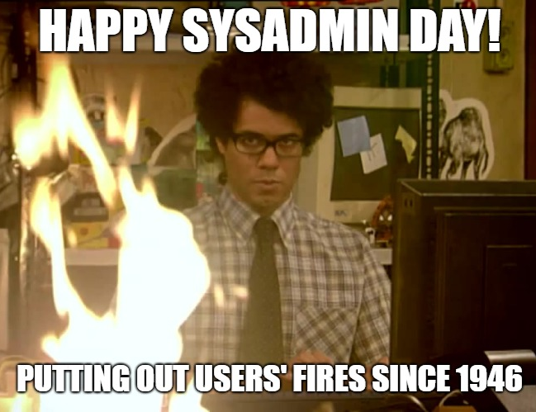
Dashboards
Know what's happening in real time
Get alerts for things you specify
Get real time data visualized
Collect multiple forms of data
Pcap
Text
Logs
Files, directories and more
Business analytics
Troubleshooting
Overall view of your server

Slide 13
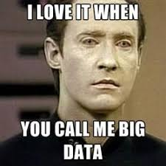
Activity - Splunk
Following the instructions in the lab on Splunk, register for a Splunk account, install it on your server and join the first topic. The link is in Blackboard for this
NOTE: You MUST use your NECC address, it only allows acces to .edu addresses.

Slide 14
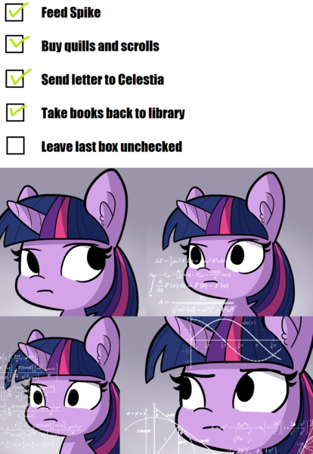
Review and checklists
How often to do checklist?
Can any be automated? (cron jobs)
Example Checklist: https://www.process.st/checklist/server-security-checklist/

Slide 15
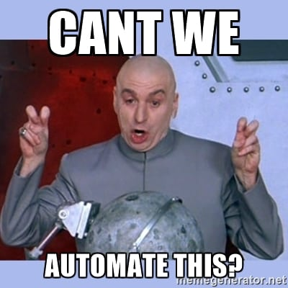
Best practices
Security in general: https://www.nist.gov/cybersecurity
Checklist repository: https://ncp.nist.gov/repository

